Slide 1

ACCOUNTING ACN 0411-2201
Prepared By: Lima Akter Antora Lecturer
Department of Business Administration University of Global Village(UGV), Barishal

Slide 2
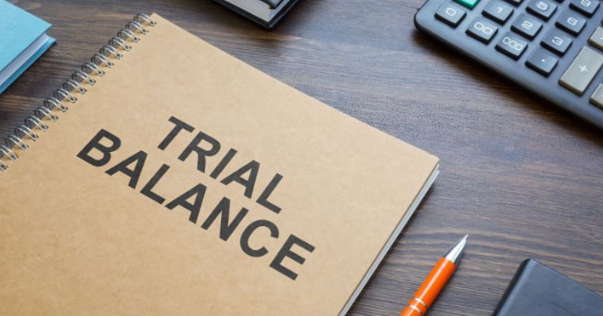
Chapter Six

Slide 3

At the end of this chapter, we will be able to
examine the arithmetical accuracy if the posting of entries is done accurately.
find out the agreement and disagreement between debit and credit balances through revealing the errors.
explain the necessity of using suspense account.
make agreement between the balances temporarily by opening suspense account.

Slide 4
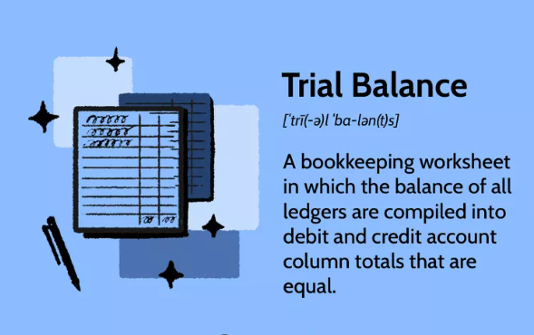

Slide 5
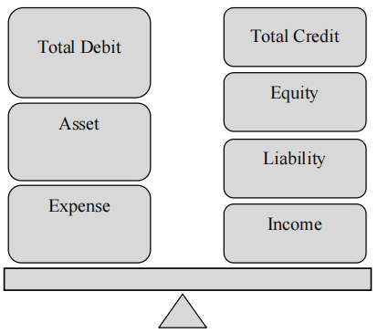
Concept of Trial Balance:
A trial balance is a list of debit and credit balances extracted from the ledger.
When the total of debit becomes equal to total of credit balances of the Trial Balance, generally it is assumed that there is no arithmetical mistake in the Ledger.
Otherwise, there might have some sort of errors and mistakes following double entry system of accounting.

Slide 6
Objectives of Trial Balance:
The main objectives of the preparation of trial balance are as follows:
Verification of posting the entries in journal and ledger accurately is one of the prime objectives of trial balance.
To facilitate in preparation of the Statement of Comprehensive Income and the Statement of Financial Position.
To discover the mistakes and rectify the errors, if any, present in the activities of maintaining journal and ledger.
To verify whether both the debit and credit aspects of the transactions as per double entry system have been recorded properly in the books of accounts.
To bring together all the balances of accounts in one place in order to facilitate the preparation of final accounts and reduce the wastage of labour and time thereby.
Trial balance can convey the information to the financial statement.

Slide 7
Procedure of preparing Trial Balance:
At first, transactions are recorded chronologically in journal and after that they are
transferred to different ledger accounts for permanent record keeping.
Without preparing the journal, transactions can also be posted directly in ledger and then the ledger accounts are balanced as well.
Then in a separate sheet of paper all the debit balances of the ledger are put on the debit column and credit balances on the credit column; eventually debit and credit columns of the list are separately totaled. This list is known as trial Balance.
It is to be mentioned here that closing stock in trade does not come in trial balance, in general but opening stock is included in it. When totals of both the columns become equal, it is assumed that the stages of accounting cycle are arithmetically accurate.

Slide 8
Pro-forma of Trial Balance:
Name of the organization
Trial Balance
As at ------- 20--------------
SL | Particulars/Accounts Name | L.F | Debit Taka | Credit Taka
Brief explanation of different columns of a trial balance is given below:
Serial/Code No.: If there is any code no. of accounts then those code no. is put, otherwise the serial no. of ledger accounts are written in this column. Such as 1, 2, 3 etc.
Name of the Accounts/ Particulars: The full name of ledger accounts whose serial numbers have been written in the first column are put in this column. Such as, capital, furniture, cash etc.
L.F. (Ledger Folio): The page/pages of the ledger, where the balances of the concerned accounts are shown, are written in this column. By doing so errors can easily be identified and rectified.
Debit Balance: The amounts of the debit balances of the ledger accounts are written in this column.
Credit Balance: The amounts of the credit balances of the ledger accounts are written in this column.

Slide 9
Factors to be considered in preparing Trial Balance:
Posting stock in trade: If opening and closing both stocks are given then closing stock in trade does not come in trial balance, because this item remains included in the opening stock in trade and purchases of the concerned year. While opening stock is included in trial balance.
Opening cash in hand and opening cash at bank: Opening cash in hand and opening cash at bank do not come to trial balance; these remain adjusted with the closing balances of cash and bank respectively.
Paid or received are not mention: Items in which paid or received are not mention specifically, they are considered as expenses and written on the debit side of trial balance. Such as, rent, discount, commission, interest etc.
Contingent liability and anticipated assets: Contingent liability and anticipated assets are not included in trial balance because business is not confirmed about their certainty. They are shown in the foot note.

Slide 10
Procedure of preparing a Trial Balance taking ledger balances into consideration:
Where only ledger balances are given in the absence of ledger, the following rules should be followed to ascertain which of the balances will be put on the debit column and on the credit column of a trial balance.
The Ledger balances which will be written on the debit side of Trial Balance | The Ledger balances which will be written on the credit side of Trial Balance
All the assets: Land, building, leasehold property, machinery, furniture, investment, bills receivable, debtors, goodwill, opening stock, cash in hand, cash at bank etc. | All liabilities: creditors, bills payable, capital, bank overdraft, loan, etc.
All expenses: Purchase, wages, salary, advertisement, rent, commission, repairs, office expenses, depreciation, bad debt, and discount allowed. | All types of income and profits: sales, interest received, discount received, apprenticeship premium, interest on investment, interest on bank deposit etc.
Expenses paid in advance: Salaries paid in advanced, wages paid in advanced, rent paid in advanced is treated as an Asset as because the future benefit will come from that type of advance payment. | Outstanding expenses and unearned incomes: Advanced rent income, Advanced consultation fee is treated as a liability as because the future service is to be provided.
Accrued incomes: Interest accrued on investment, commission accrued, rent received is treated as an Asset as because the amount realized in future. | All types of reserves: Reserve for bad and doubtful debt, general reserve, reserve for discount on debtors.
Other items: sales return, loan allowed, drawing. | Other items: purchase returns

Slide 11
Errors detected in Trial Balance:
Even after taking all necessary cautionary measures, there might have some unintentional errors, Such errors are:
Errors of Omission: While posting from journal to ledger, if mistakenly, debit has been given to the ledger but corresponding credit has not been given to the ledger account or vice versa. Moreover if any balance of account is not included in trial balance then it will not agree.
Example: Cash paid to Rahim Tk. 5000.
Journal: Rahim A/C----Dr Tk. 5,000
Cash A/C------Cr Tk. 5,000
At the time of transferring this to ledger, mistakenly it may so happen that only Rahim A/C or Cash A/C is transfer or only the balance of one account is transferred to trial balance.
Errors of Commission: Writing debit amount of the account on the credit side of the concerned ledger account or Writing credit amount of the account on the debit side of the concerned ledger account at the time of posting from journal to ledger. Both sides of trial balance will also not agree if any one side of transaction is posted twice in one account by mistake.

Slide 12
Errors detected in Trial Balance:
Even after taking all necessary cautionary measures, there might have some unintentional errors, Such errors are:
Journal: Rahim A/C----Dr Tk. 5,000
Cash A/C------Cr Tk. 5,000
If Rahim A/C----Dr is shown in credit along with Cash---- A/C on ledger or
Cash A/C Cr. is written in debit along with Rahim A/C----Dr.
Mistake in amounts of money: Writing more or less amount in the ledger mistakenly while posting from journal.
Example: Salary paid TK. 2,000. Mistake in
Journal as Salary A/C----Dr Tk. 2,000
Cash A/C------Cr Tk. 20,000
OR, while posting in ledger- Mistakenly, Salary A/C is shown as Tk. 20,000 and Cash A/C is shown as Tk. 2,000 while posting in ledger.
Error in Balancing of Ledger Account: If there is any mistake in balancing the ledger account the trial balance will not agree.

Slide 13
Errors detected in Trial Balance:
Even after taking all necessary cautionary measures, there might have some unintentional errors, Such errors are:
Mistake in transferring ledger balances to trial balance: While carrying the ledger balances to the trial balance, wrongly written the debit balance in credit side and vice versa.
Mistake in totaling both the columns in the trial balance: Trial balance will never agree if there is any mistake in doing aggregate total of trial balance.
Activity: “Even if the trial balance agrees, we cannot be certain that there is no mistake in accounts” –do you agree? Elucidate your comments.

Slide 14
Errors Not detected By the Trial Balance:
Agreement of trial does not cent percent ensure the error freeness of accounts. Usually arithmetical accuracy is assumed if trial balance agrees. But there may be some types of mistakes, which will not be detected by a trial balance. These are of two major types, e.g. clerical errors and errors of principle.
Errors
Clerical Errors
Errors of Principle
Errors of Omission
Errors of Commission
Errors of Misposting
Compensating Errors

Slide 15
Errors Not detected By the Trial Balance:
(1) Clerical errors:
Errors of omission: If any transaction is not at all recorded then the amount of the transaction will not be recorded in concerned ledger account and/or if the transaction is not transferred from journal to ledger then both the columns of trial balance will be valued by equal sum lower amount of money.
Such as, goods sold to Shimanto, but not at all recorded in sales book. Trial balance will agree
because equal amount of debit and credit has been omitted from record.
(b) Errors of commission: If any transaction is recorded in primary books of accounts by lower or higher amount of money then such lower or higher amount will also be recorded in the ledger concerned and thus the trial balance will agree as well.
Such as, goods sold to Ratan of Tk. 5,000.
If it is recorded as Tk. 50,000 then both Sales A/C and Ratan A/C will be higher valued by the amount of Tk. 45,000. Trial balance will agree in this case also.

Slide 16
Errors Not detected By the Trial Balance:
Clerical errors:
(C) Errors of miss-posting: Such errors are done because of the carelessness of the employees.
Suppose Tk. 20,000 has been received in cash from Kalam. Cash book is correctly debited with Tk. 20,000 but while posting to the ledger Salam account is credited in place of Kalam account. Trial balance will agree because the total of credits has been the same, though the amount has been credited to a wrong account.
(d) Compensating errors: If one mistake is corrected by another mistake then it is called Compensating errors.
Such as, Shiab A/C is supposed to be debited with Tk. 5,000 but it has been debited with Tk. 500. In another occasion, Jamil A/C was credited with Tk. 500 by mistake, instead of Tk. 5,000. In this case, though there are two errors even then the total of the both sides of trial balance will agree. Because both the sides will be less by the same amount i.e. Tk. 4,500.

Slide 17
Errors Not detected By the Trial Balance:
(2) Errors of Principle : Errors which are done due to the lack of proper Accounting knowledge and/ or ultra vires of recognized accounting principles are known as errors of principles. When Capital expenditure is recorded as Revenue expenditure and vice versa is example of such errors.
For example, wages paid for installation of machinery is debited to wages account
(Nominal Account) instead of machinery account (Real Account).
Activity: Detect and describe the errors and mistakes which may not be disclosed even if trial balance agrees.

Slide 18
Suspense Account:
Finding out the errors is necessary where totals of both the sides of trial balance do
not agree.
But in most of the cases the detection and rectification of errors take long time. So it is not rational and feasible to keep the work of preparation of Final Accounts pending for such long time.
Under the circumstance, disagreement of both the sides of trial balance is made equal through Suspense Account for time being. It is not a permanent solution rather a kind of temporary arrangement.
If the total of credit side of trial balance becomes less than that of debit side, the suspense account will be shown on the credit side and vice versa. Afterwards, when the errors are
detected the suspense account is closed through correction of those errors.
Activity: How the disagreement of both the sides of trial balance can be solved?

Slide 19
Example-1:
Following informations are Ledger balance of Mr. Mamun as on 31 December 2025:
Cash - 1,19,ooo; Capital- 1,00,000; Sales- 60,0000; Debtor -9,000; Purchase - 20,000; Salary- 3,000; House rent expense-7,000; Wages expense-2,000.prepare a trial balance as on 31 march , 2025.
Mr.Mamun
Trial Balance
31 March 2025
Solution:
SL. No | Name of Accounts | L.F | Debit Taka | Credit Taka
1 2 3 4 5 6 7 8 | Cash Capital Sales Sundry Debtors Purchase Salary expense House rent expense Wages expense |  | 1,19,000 9,000 20,000 3,000 7,000 2,000 | 1,00,000 60,000
 | Total |  | 1,60,000 | 1,60,000

Slide 20
Example-2:
From the following Ledger balance of Mrs. Mukta traders, prepare Trial balance as on
31 December 2025:
Name of Accounts | Taka | Name of Accounts | Taka | Name of Accounts | Taka
Capital Stock (1.1.25) Sales Gas & Water Land & Building Wages expense Debtors Commission Equipment Transportation | 60,000 16,400 81,200 840 20,000 18,490 35,800 1,470 10,270 3,370 | Drawings Business expense Cash in hand Cash at Bank Purchase Tax & Rates Furniture Bills receivable Cash at Bank(1.1.25) | 2,480 990 800 5,260 32,160 840 1,250 1,470 6,700 19,400 | Depreciation Rent received Salary expense Insurance premium Return inward Bills payable Creditors Returns outward Bank charge Discount received | 1,410 430 4,300 1,060 490 4,000 10,370 6,400 3,370 120

Slide 21
Example-3:
Mahbuba Traders prepared Trial Balance wrongly as on 31 December 2025,
you are required to prepare right Trial Balance.
SL. No | Name of Accounts | L.F | Debit Taka | Credit Taka
1 2 3 4 5 6 7 8 9 10 11 12 13 14 15 | Opening Stocks Capital Purchase Sales Commission received Salaries Expenses Rent Expenses Bad debt Machinery Debtors Creditors 6% mortgage Loan Closing stock Sales return Suspense Accounts |  | 50,000 1,00,000 10,000 20,000 3,000 5,800 40,000 10,000 80,000 | 80,000 1,00,000 12,000 35,000 2,000 89,800
 | Total |  | 2,18,800 | 2,18,800

Slide 22
Example-4:
Following Ledger balances of Shihab and Brothers as on December 2025 are as
follows:-
Name of Accounts | Taka | Name of Accounts | Taka
Capital Cash in hand(01/01/25) Debtors Creditors Drawings Purchase Sales Interest on Investment Closing Stock | 80,000 15,000 25,000 15,000 10,000 30,000 45,000 3,000 12,000 | Insurance Premium Import Duty Commission Received Investment Interest on Bank Deposit Furniture Advertisement Opening Stock Closing Bank Balance | 5,000 3,500 2,000 30,000 500 40,000 1,000 25,000 6,000
A) In Trial Balance of Shihab and Borthers which items are not recorded and what
amount of that?
B) Prepare a Trial balance of Mr. Shihab from the above Ledger balances.

Slide 23
Example-5:
Balances of Mr. Jasid as on 31 December 2025 are as follows:
Name of Accounts | Taka | Name of Accounts | Taka
Capital Drawings Bills Receivable Bills payable General Reserve Cash in hand (1-1-2025) Stocks (1-1-2025) Bad debt Provision for bad debt | 150,000 50,000 30,000 25,000 5,000 6,000 40,000 5,000 3,000 | Building Debtors Creditors Salaries Apprentice premium (prepaid) Bank overdraft Cash in hand (31-12-2025) Insurance Stocks(31-12-2025) | 45,000 30,000 25,000 5,000 3,000 2,000 10,000 8,000 35,000
A. In the Trial Balance of Mr. Jasid which balances are not recorded and what amount of that?
B. From the above balance prepared a Trial Balance of Mr. Jasid.
C. Determine Current Assets and Short-term Liabilities of Mr. Jasid.

Slide 24
Example-6:
In the light of steams prepared valid Trial Balance:
Accountant of Mrs. Saleh and Co. prepared Trial Balance but there are some irrelevances in that. Wrong Trail Balance is as follows:
SL. No | Name of Accounts | L.F | Debit Taka | Credit Taka
1 2 3 4 5 6 7 8 9 10 11 12 13 14 | Opening stocks Purchase Salaries Creditors Debtors Bank balance Return inward Carriage outward Bills payable Loan Building Discount allowed Capital Sales |  | 34,000 1,00,000 12,000 40,000 16,000 3,000 20,000 55,000 | 45,000 5,000 13,000 10,000 67,000 1,40,000
 | Total |  | 2,80,000 | 2,80,000

Slide 25
Thank You

